Slide 1
Python Libraries for Data Analysis and Visualization
Tech Intersections March 26, 2022

Slide 2
Lourdes Ovando
10 + years as a Developer with a focus on data
HealthCare and Higher Education Industries
Projects
Data Analysis
Reporting
Dashboard
Data Modeling
ETL
Integration
Interests and Goals
Data Engineering
Automation
Scripting
Data Science
Background
CSU Bakersfield
First Generation
Graduated at 28 yrs old
WomenTechmaker Ambassador
https://www.wtmmodesto.com/

Slide 3
Today’s Agenda
Python Libraries for Data Analysis and Visualization
Getting started with Python
Python Libraries
Pandas
Matplotlib
Seaborn
Additional Libraries
Questions?

Slide 4
Working with Data
Raw data
Often messy
Often inconsistent
Designed for write and not for read
Data Warehouse
Improved design for read
Views/Modeled Data
Easiest to work with

Slide 5
Recent Example
Women Techmakers Modesto - International Women’s Day Event (Free event)
Registration
GDG platform
Secondary Registration method for those that had issues with GDG Platform
Paper Sign-In sheet at event
How many people attended?
How do we make the process automated and repeatable?
What if someone signed up more than once with two different names?

Slide 6
One data point - several points of view
Attendance
Presenter/Speaker
Impact - Only attendees that were present during the presentation
Organizer
Food - All who attended including children and non registered guests

Slide 7
Today’s Agenda
Python Libraries for Data Analysis and Visualization
Getting started with Python
Python Libraries
Pandas
Matplotlib
Seaborn
Additional Libraries
Questions?

Slide 8


Development Environment
Anaconda
https://www.anaconda.com/products/individual?modal=commercial
Jupyter Lab and Notebook
https://jupyter.org/try
Google Colab
https://colab.research.google.com/?utm_source=scs-index

Slide 9

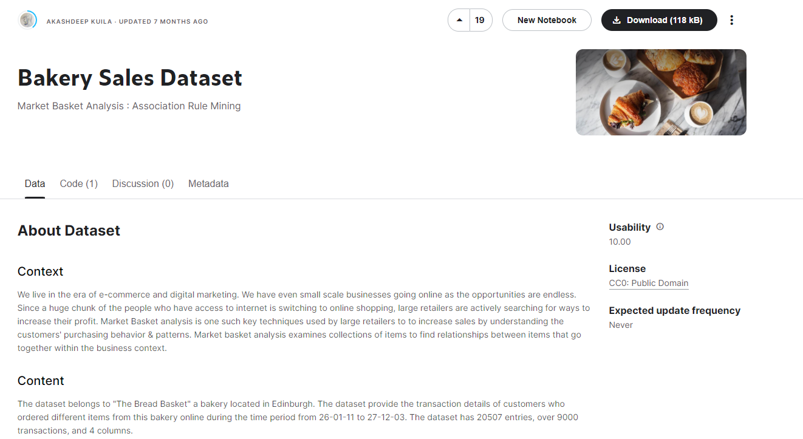
The data set for today - Bakery.csv
Where can I find data?
Database
applications
Online
Kaggle, Data.gov, search for open datasets
API
Spotify, Github
https://www.kaggle.com/datasets/akashdeepkuila/bakery

Slide 10
Today’s Agenda
Python Libraries for Data Analysis and Visualization
Getting started with Python
Python Libraries
Pandas
Matplotlib
Seaborn
Additional Libraries
Questions?

Slide 11
Today’s Agenda
Python Libraries for Data Analysis and Visualization
Getting started with Python
Python Libraries
Pandas
Matplotlib
Seaborn
Additional Libraries
Questions?

Slide 12
Today’s Agenda
Python Libraries for Data Analysis and Visualization
Getting started with Python
Python Libraries
Pandas
Matplotlib
Seaborn
Additional Libraries
Questions?

Slide 13
Today’s Agenda
Python Libraries for Data Analysis and Visualization
Getting started with Python
Python Libraries
Pandas
Matplotlib
Seaborn
Additional Libraries
Questions?

Slide 14
Additional Libraries
Web Scraping
Selenium
https://selenium-python.readthedocs.io/
SQL
SQLAlchemy
https://www.sqlalchemy.org/

Slide 15
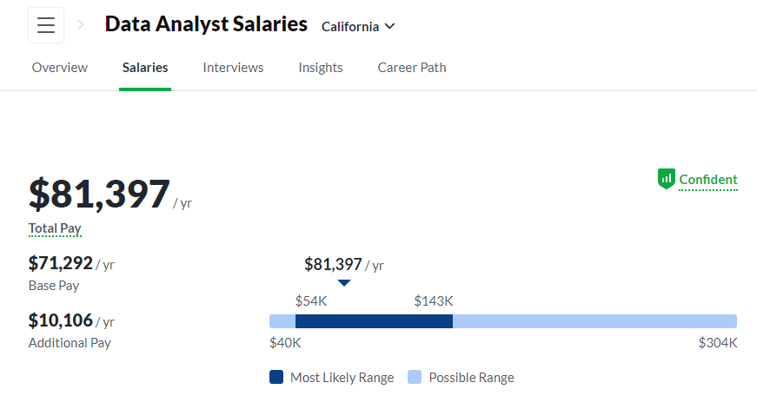
Careers in Data
Data Analyst
Uses data to answer business questions
https://www.glassdoor.com/Salaries/california-data-analyst-salary-SRCH_IL.0,10_IS2280_KO11,23.htm

Slide 16
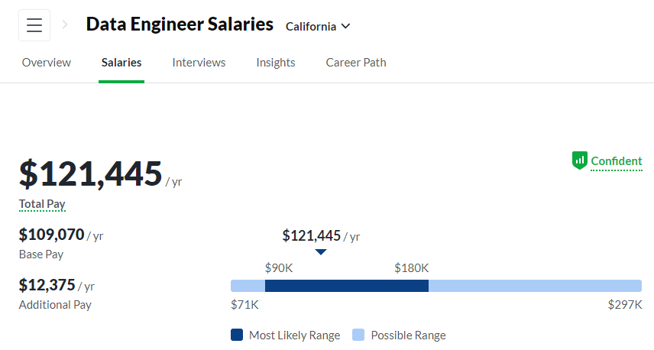
Careers in Data
Data Engineer
Develops dataset processes
https://www.glassdoor.com/Salaries/california-data-engineer-salary-SRCH_IL.0,10_IS2280_KO11,24.htm

Slide 17
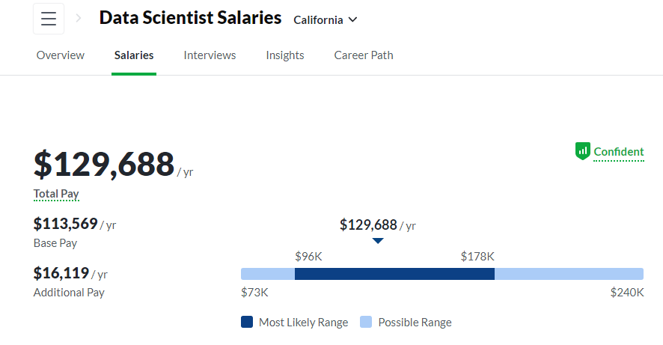
Careers in Data
Data Scientist
Build predictive models and machine-learning algorithms
https://www.glassdoor.com/Salaries/california-data-scientist-salary-SRCH_IL.0,10_IS2280_KO11,25.htm

Slide 18
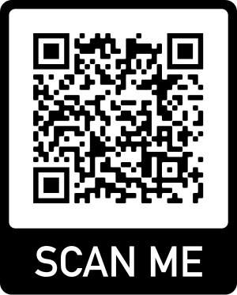
Questions?
Github https://github.com/ovando-lulu/2022-tech-intersections-python

